Slide 1
AQ Bench Findings

Slide 2
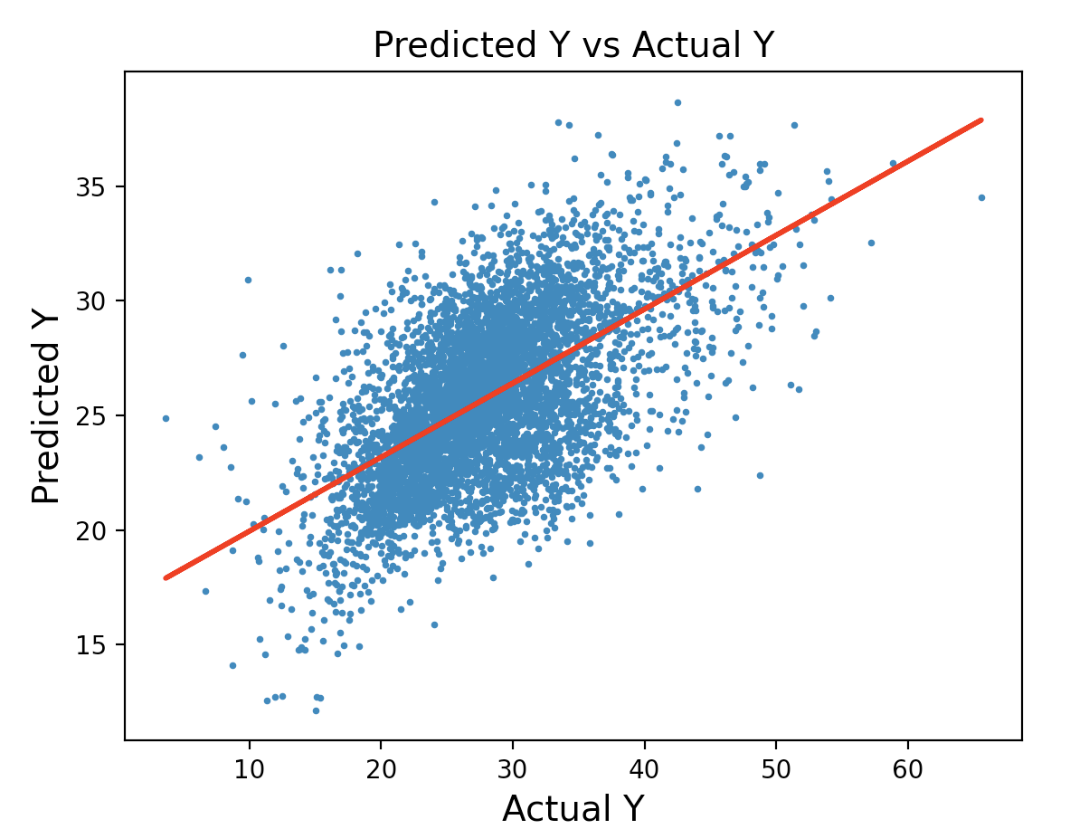
Root Mean Squared Error = 5.613307806802032
r correlation = 0.5887158571304695
Notes:
plt.hist()
Plot distribution of y and ypred
Create bins
Overlay normal distribution

Slide 3
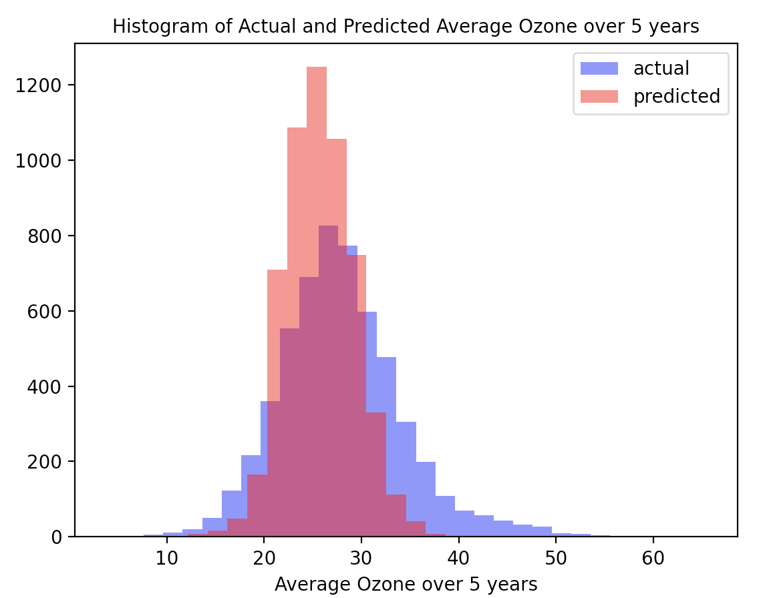

Slide 4
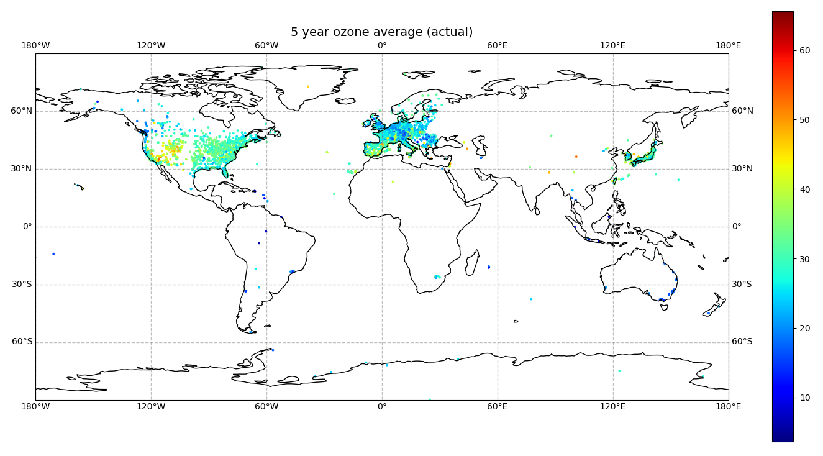

Slide 5
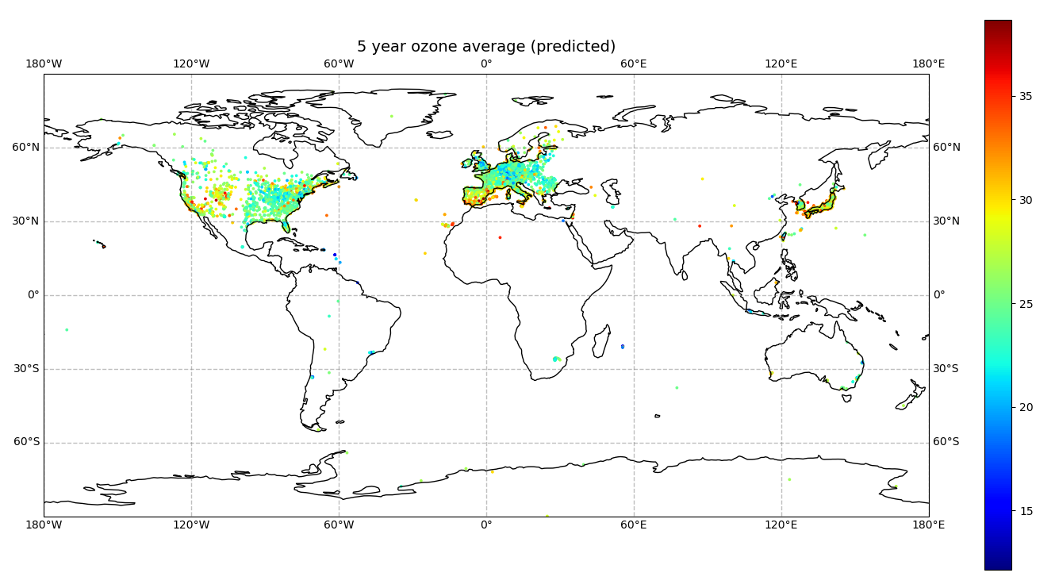

Slide 6
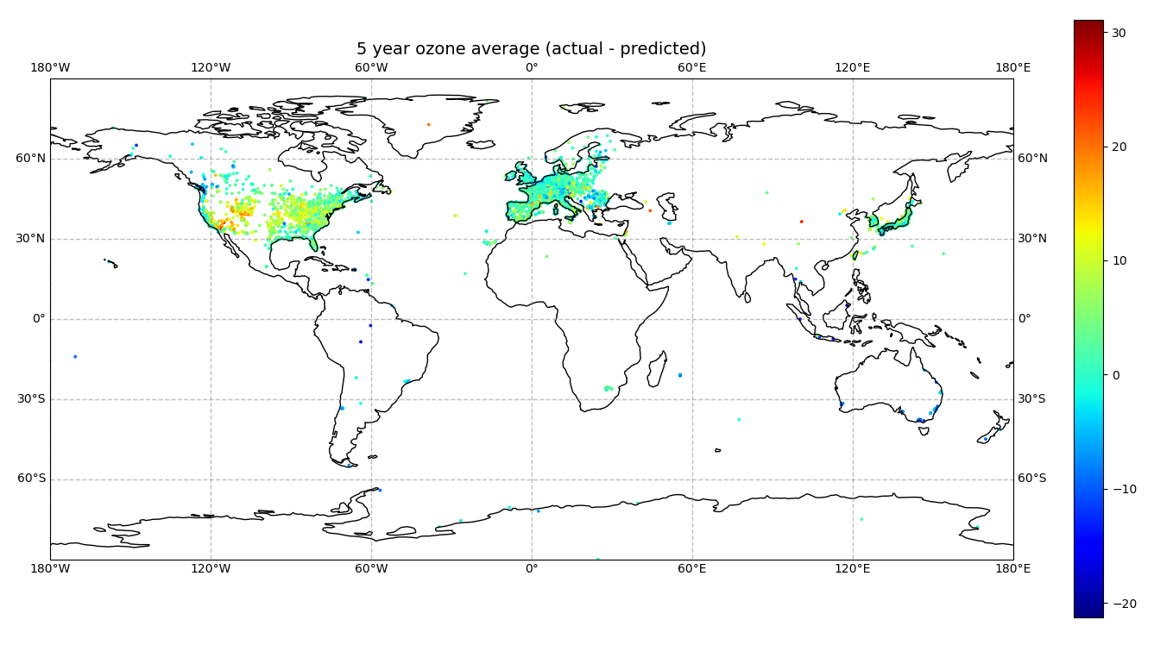

Slide 7
